Slide 1


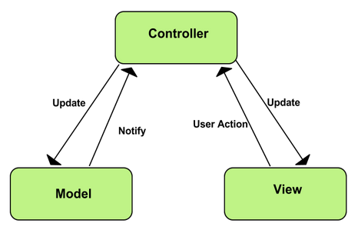

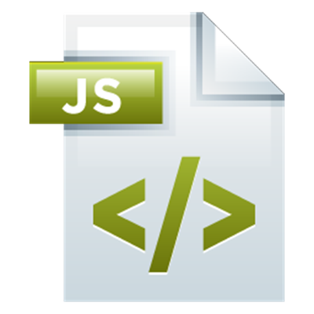
MVC Architecture. Routing
Model-View-Controller.
Using React Router in JS SPA
MVC + Routing
SoftUni Team
Technical Trainers
Software University
http://softuni.bg

Slide 2


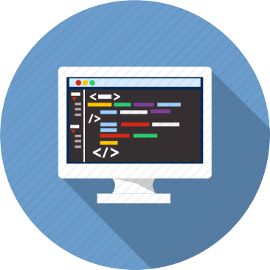
Table of Contents
MVC in JavaScript
Models
Views
Controllers
Web Routing
ReactJS

Slide 3
Have a Question?
sli.do #3243

Slide 4
MVC Architecture Overview
Terminology
Models – describe data and rules for handling data
Views – represent parts of the data to the user
Controllers – parse user input to views and models

Slide 5
MVC Example
Controller
Supervises the data transfer and communication between the Model and the View…
Model
View
Communication with the Database…
User interaction, Data visualization...
Database
User

Slide 6
Model
Entity Model
Represents the data stored in a DB
Represented in memory
You can create, edit and delete an entity
You can filter and sort entities by specific criteria

Slide 7
View
Entity details page
Displays only a section of the data the Model served
The same data can be shown by different Views
Style can be altered independent of the data

Slide 8
Controller
Edit entity
Reads and parses information the User submitted
Instructs the View to update accordingly
Sends parsed information to the Model

Slide 9
MVC in JavaScript with React
React Controller Views and stateless Views
Lift shared data to common ancestor
Split components in smaller pieces
Provide a central source of truth and parsing
Models – data management and storage inside Controller View or in separate module

Slide 10
Web Routing
index.html
HTML
Catalog
HTML
New Products
HTML
About
HTML
Discount
HTML
Contact
HTML

Slide 11
Web Routing Overview
Problem
Changing the URL reloads the page
Solution
Single Page Application with JavaScript

Slide 12
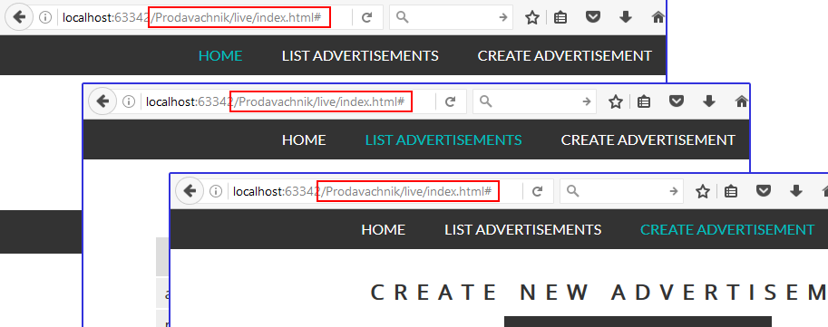
Web Routing Overview (2)
New Problem
We can't track browser history
Back button won't work

Slide 13
Web Routing Overview (2)
Solution
Reflect content changes in the URL
Track URL changes and load content

Slide 14

React Router
A React add-on for web routing

Slide 15
What is React Router?
React Router is a complete routing library for React
Keeps the UI in sync with the URL
ReactDOM.render((
<Router history={hashHistory}>
<App>
<Route path="/catalog" component={Catalog}/>
<Route path="/about" component={About}/>
</App>
</Router>
), document.getElementById('root'))

Slide 16
Installation and Setup
Install using npm from the terminal
Import modules in your app
npm install --save react-router
import { Router, browserHistory } from 'react-router'
import { Route, IndexRoute, Link } from 'react-router'

Slide 17
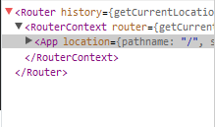
Rendering a Route
React Router is a component
It can be rendered as any React component
React components can be nested in it as normal
render(<Router/>, document.getElementById('app'))
render((
<Router history={hashHistory}>
<App />
</Router>
), document.getElementById('app'))

Slide 18
Adding more scenes
React components can be wrapped in a Route and bound to a specific path
Access URL
<Router history={hashHistory}>
<Route path="/" component={App}/>
<Route path="/catalog" component={Catalog}/>
<Route path="/about" component={About}/>
</Router>
Component to load

Slide 19
Navigating with Link
Link replaces <a> and automatically prevents page reload
let App = React.createClass({
render() {
return (
<div><h1>React Router Tutorial</h1>
<Link to="/catalog">Catalog</Link>
<Link to="/about">About</Link>
</div>
)
}})
Access URL as defined in Route

Slide 20
Nested Routes
With props.children we can dynamically nest components
let App = React.createClass({
render() {
return (
<div><h1>React Router Tutorial</h1>
<Link to="/catalog">Catalog</Link>
<Link to="/about">About</Link>
{this.props.children}
</div>
)
}})

Slide 21
Nested Routes (2)
Our navigation links will now appear on all pages
Nested routes will appear as children inside App
ReactDOM.render((
<Router history={hashHistory}>
<Route path="/" component={App}>
<Route path="catalog" component={Catalog}/>
<Route path="about" component={About}/>
</Route >
</Router>
), document.getElementById('root'))

Slide 22
Active Links
Links know when they are currently active
We can style them with activeStyle or activeClassName
<Link to="/catalog" activeStyle={{ color: 'red' }}>
Catalog
</Link>
<Link to="/catalog" activeClassName="activeNav">
Catalog
</Link>

Slide 23
Index Routes
We can specify a default component when no route is active
Will display as children when we open "/"
<Router history={hashHistory}>
<Route path="/" component={App}>
<IndexRoute component={Home}/>
<Route path="catalog" component={Catalog}/>
<Route path="about" component={About}/>
</Route >
</Router>

Slide 24
Clean URLs with Browser History
Configure the Router to work with browserHistory
This removes the pound sign from our links (#)
import { browserHistory } from 'react-router'
render((
<Router history={browserHistory}>
…
</Router>
), document.getElementById('app'))

Slide 25
URL Params
Parameters are dynamic parts of the URL
Example: /catalog/elecronics/XYZ5538
Configure the Route to work with params
Access from the component
This part of the URL can change
<Route path="/catalog/:category/:userId" component={Catalog}/>
this.props.params.category

Slide 26
Additional usage
Redirects
Transitions
NotFoundRoute (custom client 404)
Important side points
React.PropTypes – required properties and type validation
Elevating state to allow communication between components (Controller View and stateless components)
props.children – dynamically define nested components/elements
render() { return null } to hide component

Slide 27


Practice: Routing with React Router
Live Exercises in Class (Lab)

Slide 28


Summary
MVC makes large projects easier to manage
With React Router we can compose a large app from smaller pieces
<Router history={hashHistory}>
<Route path="/" component={App}>
<Route path="catalog" component={Catalog}/>
<Route path="about" component={About}/>
</Route >
</Router>

Slide 29









MVC Architecture. Routing
https://softuni.bg/courses/javascript-applications

Slide 30
License
This course (slides, examples, demos, videos, homework, etc.) is licensed under the "Creative Commons Attribution-NonCommercial-ShareAlike 4.0 International" license

Slide 31






Free Trainings @ Software University
Software University Foundation – softuni.org
Software University – High-Quality Education, Profession and Job for Software Developers
softuni.bg
Software University @ Facebook
facebook.com/SoftwareUniversity
Software University @ YouTube
youtube.com/SoftwareUniversity
Software University Forums – forum.softuni.bg

